Slide 1

Climate-Induced Disaster Prediction

Slide 2
Introduction
AIM OF THE PROJECT: Predicting climate-induced disasters, and floods using some ‘Machine Learning’ and ‘Deep Learning’ models.
SOURCE OF IDEA: Research paper by Haggag
AIM OF THIS PAPER: Predicting the occurrence of CID by linking different climate change indices to historical disaster records.
CLIMATE CHANGE
Accelerated sea level rise
Frequent waves and droughts
Intense hurricanes
A continuous and rapid rise in temperatures
Increased loss of snow cover
Three of the top five risks with respect to likelihood and impact are climate related with extreme weather events being the highest ranked risk

Slide 3
Details about Haggag’s Research Paper
AIM OF THE MODEL: To predict floods in Ontario region of Canada by using some climate parameters to train the model to be used.
In this paper a deep learning (neural network) model for CID prediction is developed by linking historical disaster records to different climate change indices.
The paper is divided into 2 main parts
CONCLUSION: The variable frequency analysis shows that three of the most frequent variables are actually temperature related which supports the direct and strong relationship that exists between temperature changes and flooding
As the air gets warmer, its ability to hold water vapour increases (e.g., air contains around 7% more moisture for each 1 °C temperature increase), and this moisture turns into rain when condensation occurs due to temperature drop.
The general model structure that is generic enough to be employed to predict any class of CID in any location given the availability of influencing spatiotemporal climate data
Demonstrates the applicability of the developed model using Ontario’s disaster records and relevant climate change indices data

Slide 4
Selection of Parameters
We attempted to obtain similar parameters used in the paper and apply them to the Indian scenario in the state of Kerala.
Also, in the Canada Model some other parameters were used but they were irrelevant to the Indian scenario, so they were dropped.
DTR(Daily Temperature Range)
(SS of Formula to be included here)
CWD(Maximum length of wet spell)
TN10P
TX10p
The largest number of consecutive days where RRij≥1 mm, where RRij is the daily precipitation amount on day i in period j.
Where TXij and TNij are the daily maxima and minimum temperature, respectively, on the day i in period j.
Percentage of days when TNij<TNin10, where TNij is the daily minimum temperature on the day i in period j and TNin10 is the calendar day 10th percentile centred on a 5-day window for the base period 1961–1990.
Percentage of days when TX<10th percentile.
Now, for calculation of these parameters' python was used and the codes will be attached below. Also, use of excel was done.

Slide 5
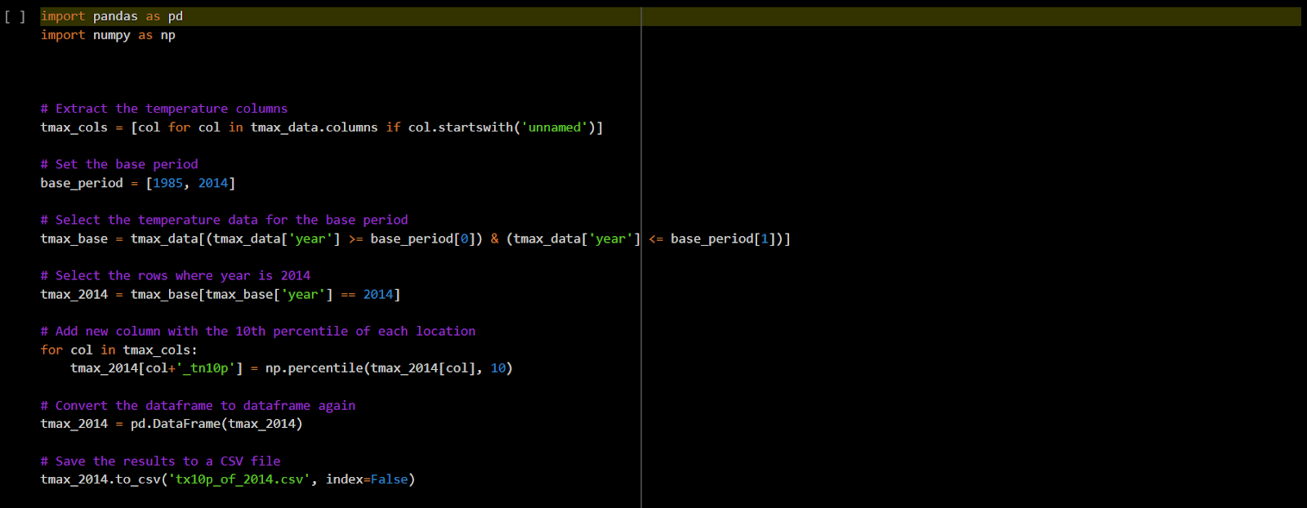
Codes Used To Find Parameters

Slide 6
Location of Study and Result
Since the dataset was maximum for Kerala it was preferred. Although with sufficient training data, any region of India could be used.
Now to incorporate all weather conditions regions surrounding Kerala were taken and some points of Rajasthan were included to incorporate extreme conditions. The attempt was done to collect sufficient yes and no points for the flood to make sure data is not skewed.
Based on the sensitivity analysis performed, the best-performing models are selected
Furthermore, the confusion matrix of the selected models will be compared to select the best-performing model accordingly.
Model validation is employed by comparing the model prediction results to actual disaster records that are not included in the model input data.
The results and complete code is in this colab notebook https://colab.research.google.com/drive/1m18GnPM47RqbfS9IS0oTHc9IeTayDABN?usp=sharing

Slide 7
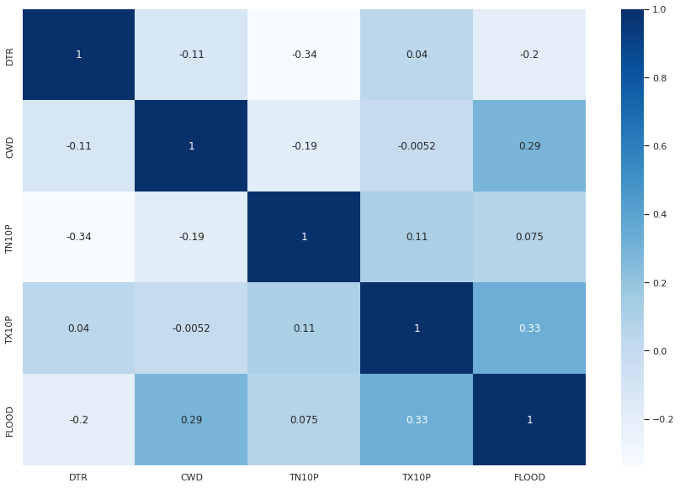
Correlation Values
We observed that TX10P and CWD give the maximum correlation with the output variable(FLOOD)

Slide 8
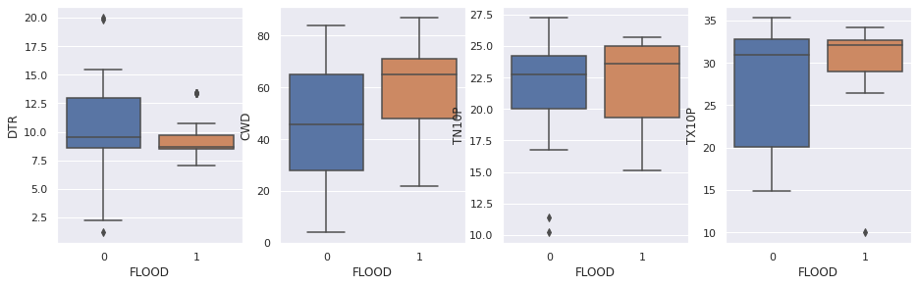
P-VALUES:-
CWD : P VALUE: 0.00215
DTR : P-VALUE: 0.00715
TN10P : P-VALUE: 0.19678
TX10P : P-VALUE: 0.01739
BOX PLOTS AND OUTLIER ANALYSIS: -(FOR OUTLIERS)
The p-value is used to determine the statistical significance of the results of a hypothesis test. If the p-value is very small (usually less than 0.05 or 0.01), it suggests that the observed result is unlikely to have occurred by chance, and the null hypothesis can be rejected. On the other hand, if the p-value is relatively large, it suggests that the observed result is not unusual, and the null hypothesis cannot be rejected.
So our null hypothesis was that there was no discrepancy in the data at the time of it was collected and it was independent of all the parameters

Slide 9
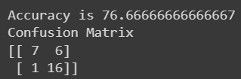
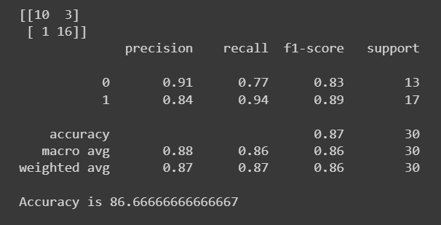
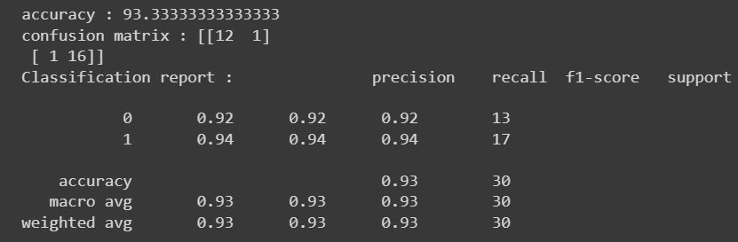
Accuracy and classification reports of the channel
LOGISTIC REGRESSION:-
DECISION TREE:-
Upsampling is a technique used in statistics and
machine learning to address imbalanced datasets,
by increasing the number of samples in the minority class.
XGBOOST(WITH UNSAMPLING):-

Slide 10
CONCLUSION
Our models and techniques to calculate and fill the data worked well, as seen from the p-values.
Our choice of parameters also worked well, as seen from the correlation values.
Also, from upsampling, the accuracy increased with XGBoost, so it also worked well.
Thus, our work can be expanded for different regions also.

